Slide 2
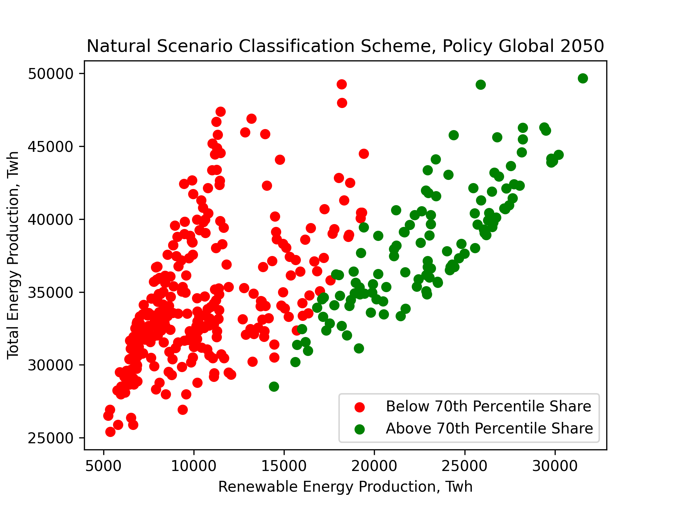
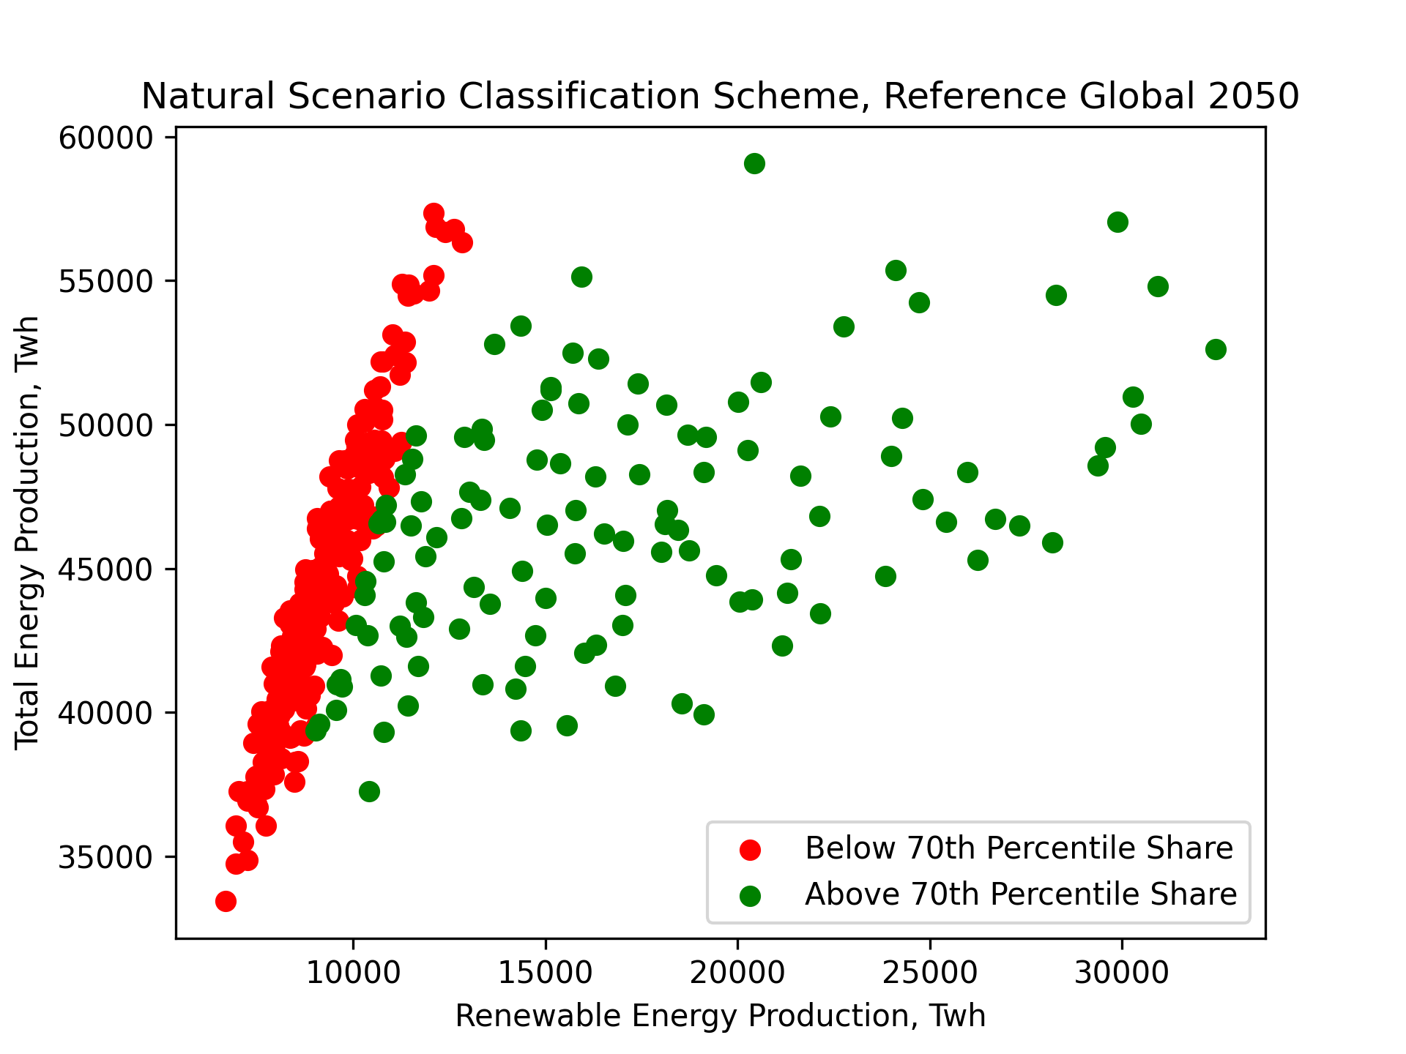
Why Classification?

Slide 3
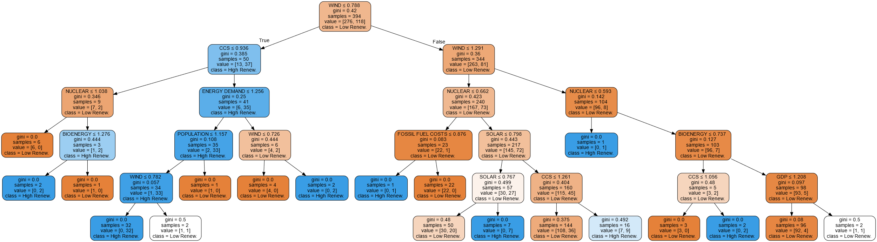
Methodology Example

Slide 4
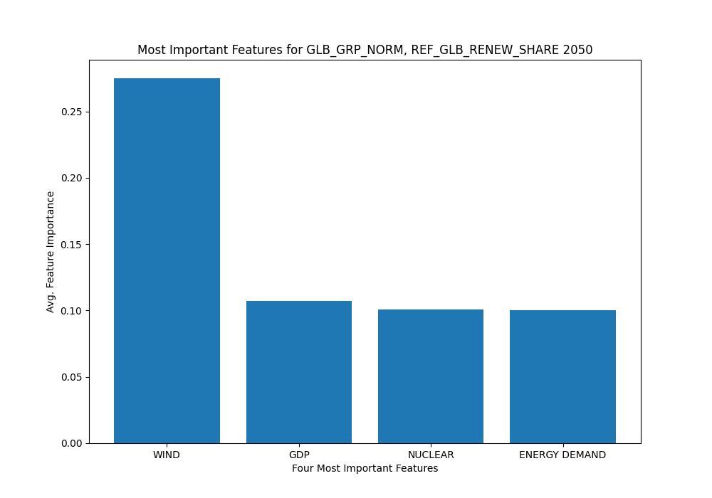
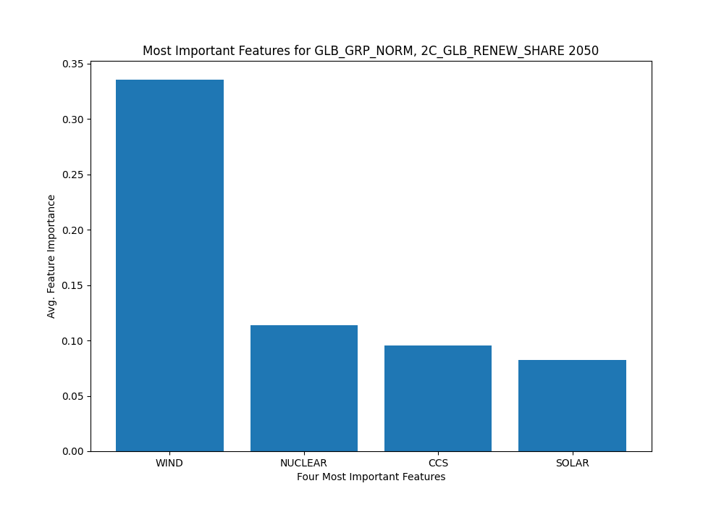
Methodology Example

Slide 5
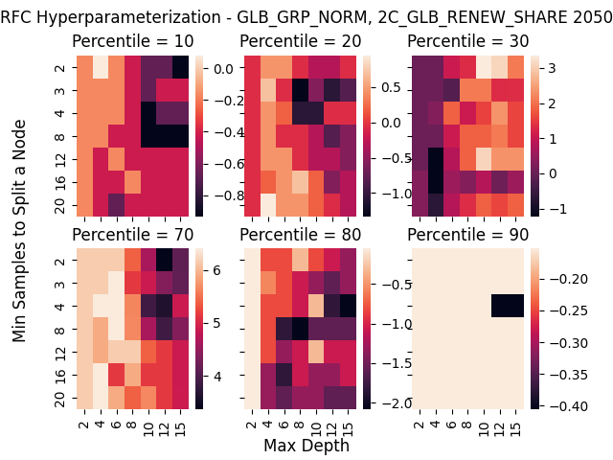
Methodology Example

Slide 6
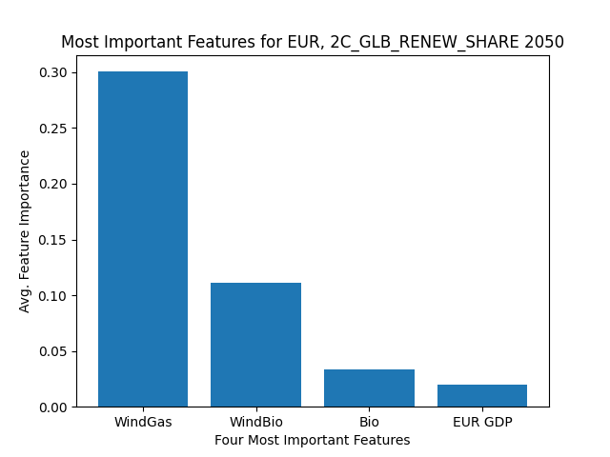
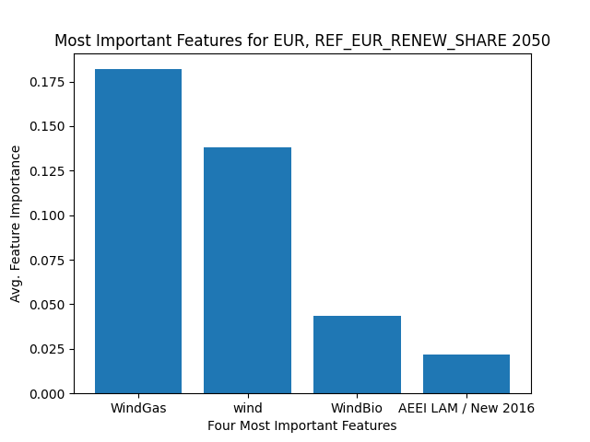
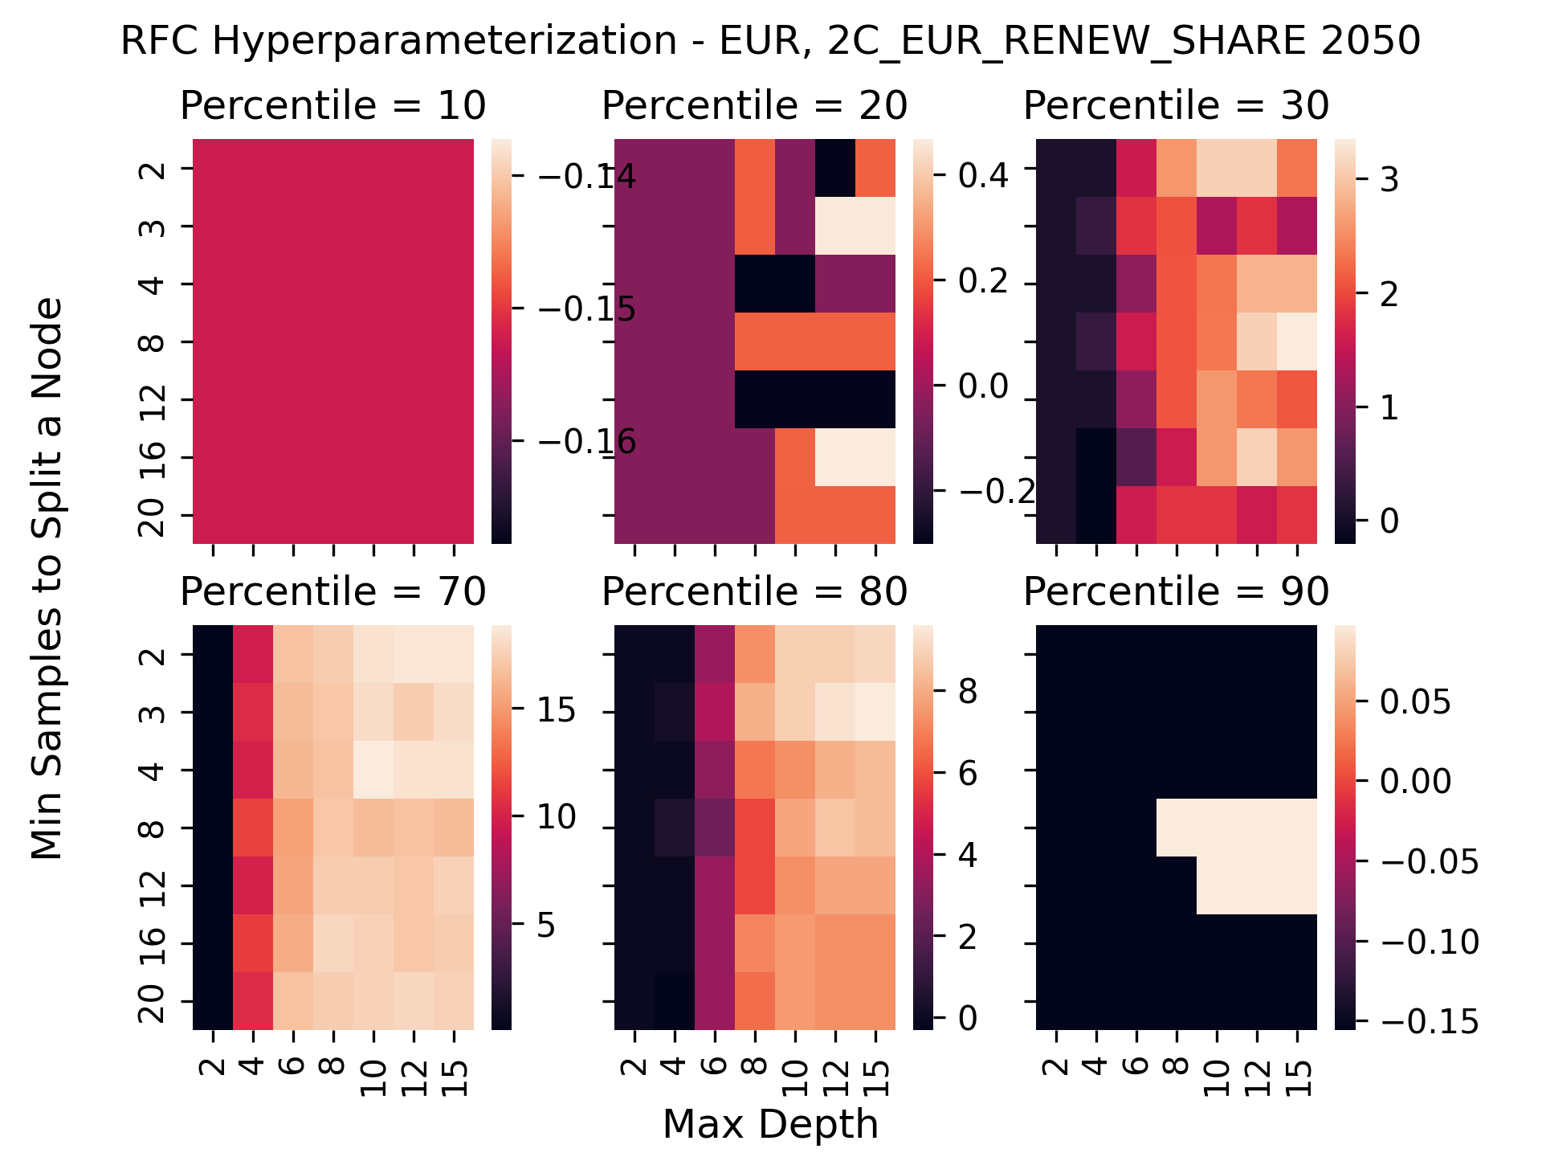
Regional Cases
WindGas ≤ 0.8
gini = 0.42
samples = 394
value = [276, 118]
class = Low Renew.
Bio ≤ 0.696
True
False
WindBio ≤ 0.48
gini = 0.293
gini = 0.167
samples = 112
samples = 282
value = [20, 92]
value = [256, 26]
class = High Renew.
class = Low Renew.
WindGas ≤ 0.641
EUR GDP ≤ 2.516
AEEI KOR / New 2016 ≤ 0.824
EUR GDP ≤ 4.524
gini = 0.494
gini = 0.19
gini = 0.497
gini = 0.096
samples = 18
samples = 94
samples = 24
samples = 258
value = [10, 8]
value = [10, 84]
value = [11, 13]
value = [245, 13]
class = Low Renew.
class = High Renew.
class = High Renew.
class = Low Renew.
gini = 0.0
NGCC ≤ 0.892
AEEI LAM / New 2016 ≤ 1.315
Non-EUR GDP ≤ 9.758
AEEI RUS / New 2016 ≤ 0.365
Non-EUR Pop ≤ 1.666
FF-OIL / New 2016 ≤ 0.512
VINT / New 2016 ≤ 0.432
samples = 6
gini = 0.278
gini = 0.48
gini = 0.145
gini = 0.298
gini = 0.26
gini = 0.07
gini = 0.494
value = [0, 6]
samples = 12
samples = 5
samples = 89
samples = 11
samples = 13
samples = 249
samples = 9
class = High Renew.
value = [10, 2]
value = [3, 2]
value = [7, 82]
value = [9, 2]
value = [2, 11]
value = [240, 9]
value = [5, 4]
class = Low Renew.
class = Low Renew.
class = High Renew.
class = Low Renew.
class = High Renew.
class = Low Renew.
class = Low Renew.
LK OTHR / New 2016 ≤ 1.049
gini = 0.0
gini = 0.0
gini = 0.0
FF-COAL / New 2016 ≤ 1.763
gini = 0.0
gini = 0.0
gini = 0.0
gini = 0.0
gini = 0.0
gini = 0.0
LK TRANS / New 2016 ≤ 0.585
gini = 0.0
gini = 0.0
gini = 0.444
samples = 9
samples = 3
samples = 2
gini = 0.127
samples = 1
samples = 2
samples = 9
samples = 11
samples = 2
samples = 1
gini = 0.062
samples = 4
samples = 5
samples = 3
value = [9, 0]
value = [3, 0]
value = [0, 2]
samples = 88
value = [1, 0]
value = [0, 2]
value = [9, 0]
value = [0, 11]
value = [2, 0]
value = [0, 1]
samples = 248
value = [0, 4]
value = [5, 0]
value = [1, 2]
class = Low Renew.
class = Low Renew.
class = High Renew.
value = [6, 82]
class = Low Renew.
class = High Renew.
class = Low Renew.
class = High Renew.
class = Low Renew.
class = High Renew.
value = [240, 8]
class = High Renew.
class = Low Renew.
class = High Renew.
class = High Renew.
class = Low Renew.
gini = 0.0
gini = 0.0
gini = 0.108
gini = 0.0
gini = 0.0
gini = 0.055
samples = 2
samples = 1
samples = 87
samples = 1
samples = 1
samples = 247
value = [0, 2]
value = [1, 0]
value = [5, 82]
value = [1, 0]
value = [0, 1]
value = [240, 7]
class = High Renew.
class = Low Renew.
class = High Renew.
class = Low Renew.
class = High Renew.
class = Low Renew.

Slide 7
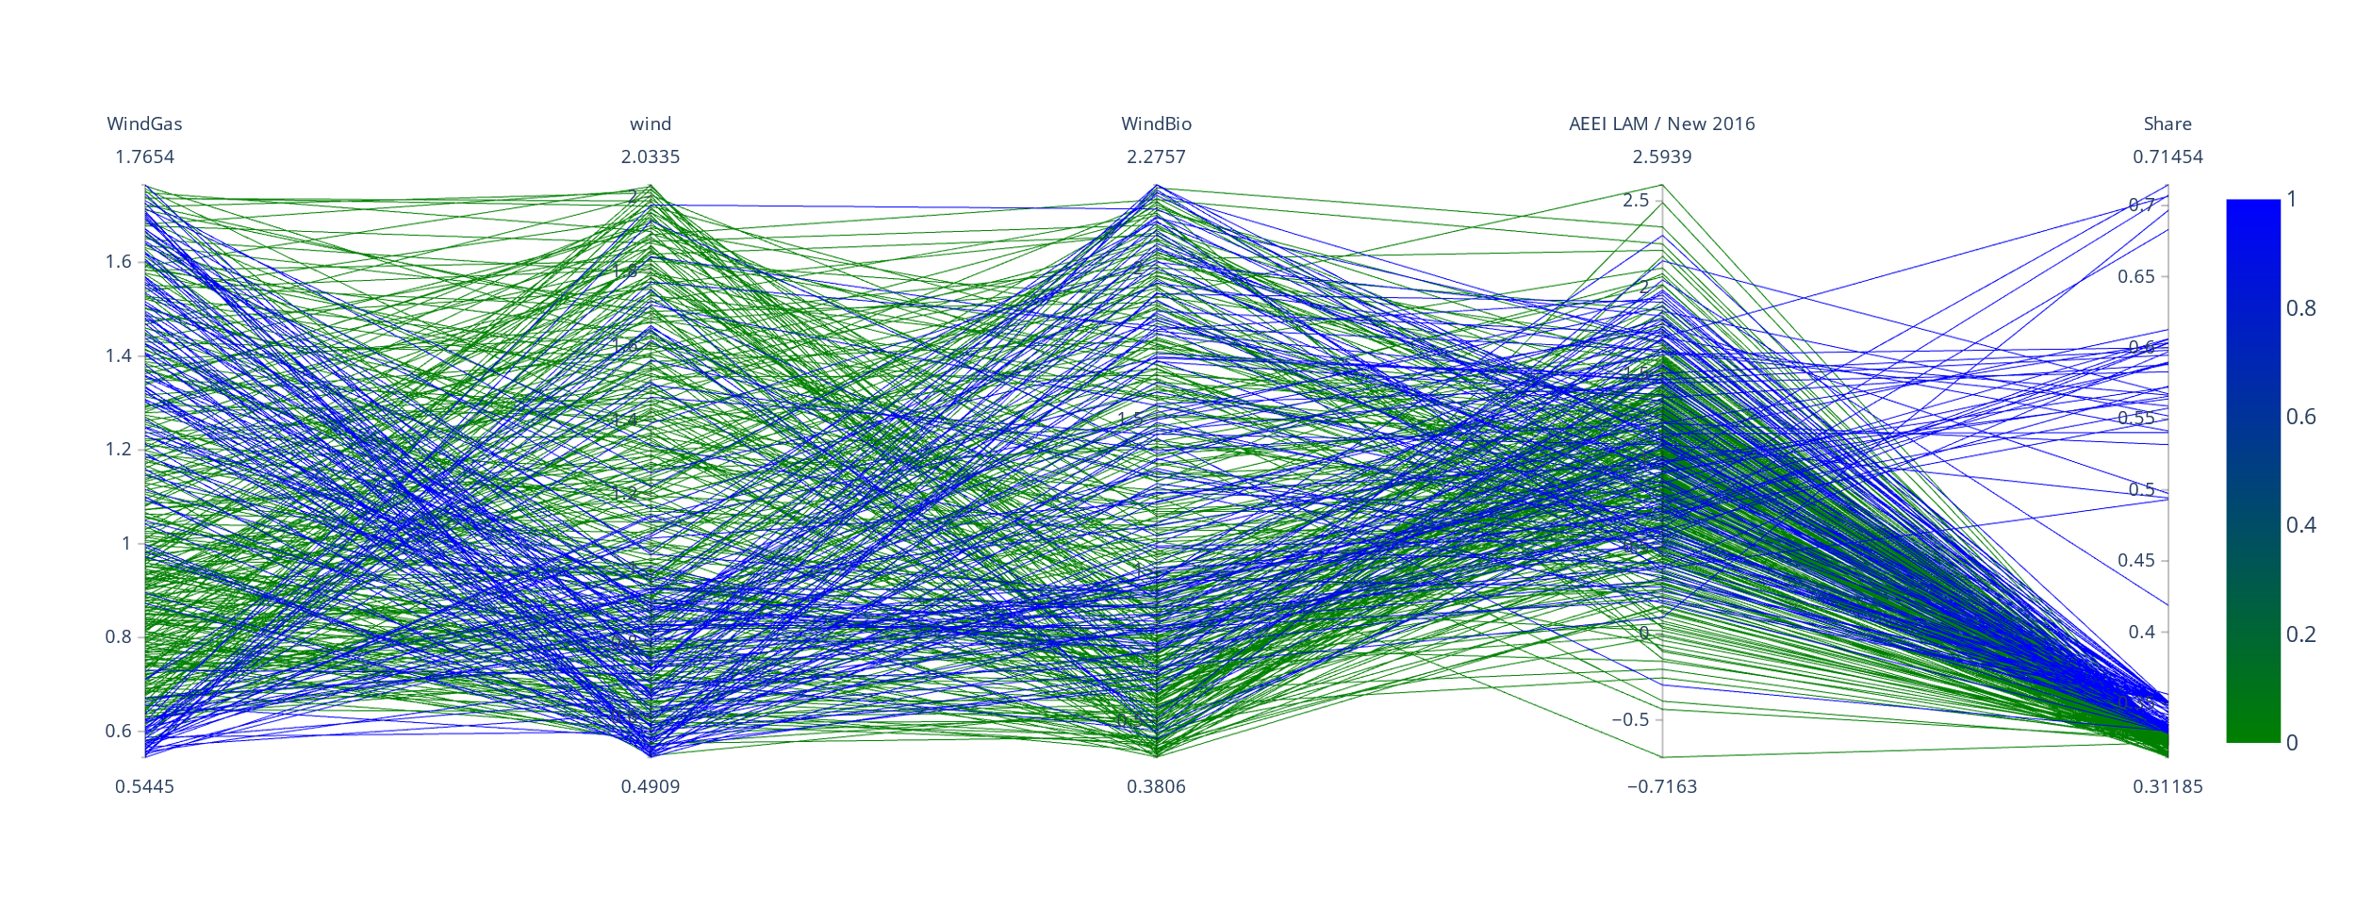
Regional Cases

